Slide 1
User defined functions, Storage classes

Slide 2
Function prototype
The Function prototype serves the following purposes –
1) It tells the return type of the data that the function will return.
2) It tells the number of arguments passed to the function.
3) It tells the data types of each of the passed arguments.
4) Also it tells the order in which the arguments are passed to the function.
Therefore essentially, the function prototype specifies the input/output interlace to the function i.e. what to give to the function and what to expect from the function.
The prototype of a function is also called the signature of the function.

Slide 3
Static functions in C
In C, functions are global by default. The “static” keyword before a function name makes it static. For example, below function fun() is static.
Unlike global functions in C, access to static functions is restricted to the file where they are declared. Therefore, when we want to restrict access to functions, we make them static. Another reason for making functions static can be reuse of the same function name in other files.

Slide 4
Function definition
A function is a group of statements that together perform a task. Every C program has at least one function, which is main(), and all the most trivial programs can define additional functions.
A function declaration tells the compiler about a function's name, return type, and parameters. A function definition provides the actual body of the function.
Defining a Function
The general form of a function definition in C programming language is as follows −
return_type function_name( parameter list ) {
body of the function
}

Slide 5
Defining a Function
Return Type − A function may return a value. The return_type is the data type of the value the function returns. Some functions perform the desired operations without returning a value. In this case, the return_type is the keyword void.
Function Name − This is the actual name of the function. The function name and the parameter list together constitute the function signature.
Parameters − A parameter is like a placeholder. When a function is invoked, you pass a value to the parameter. This value is referred to as actual parameter or argument. The parameter list refers to the type, order, and number of the parameters of a function. Parameters are optional; that is, a function may contain no parameters.
Function Body − The function body contains a collection of statements that define what the function does.

Slide 6
Calling a Function
While creating a C function, you give a definition of what the function has to do. To use a function, you will have to call that function to perform the defined task.
When a program calls a function, the program control is transferred to the called function. A called function performs a defined task and when its return statement is executed or when its function-ending closing brace is reached, it returns the program control back to the main program.
To call a function, you simply need to pass the required parameters along with the function name, and if the function returns a value, then you can store the returned value.

Slide 7
Function Arguments
If a function is to use arguments, it must declare variables that accept the values of the arguments. These variables are called the formal parameters of the function.
Formal parameters behave like other local variables inside the function and are created upon entry into the function and destroyed upon exit. By default, C uses call by value to pass arguments.
Sr.No. | Call Type & Description
1 | Call by value This method copies the actual value of an argument into the formal parameter of the function. In this case, changes made to the parameter inside the function have no effect on the argument.
2 | Call by reference This method copies the address of an argument into the formal parameter. Inside the function, the address is used to access the actual argument used in the call. This means that changes made to the parameter affect the argument.

Slide 8
Function call by Value in C
By default, C programming uses call by value to pass arguments. In general, it means the code within a function cannot alter the arguments used to call the function. Consider the function swap() definition as follows.
/* function definition to swap the values */
void swap(int x, int y) {
int temp;
temp = x; /* save the value of x */
x = y; /* put y into x */
y = temp; /* put temp into y */
return;
}

Slide 9
Function call by reference in C
To pass a value by reference, argument pointers are passed to the functions just like any other value. So accordingly you need to declare the function parameters as pointer types as in the following function swap(), which exchanges the values of the two integer variables pointed to, by their arguments.
/* function definition to swap the values */
void swap(int *x, int *y) {
int temp;
temp = *x; /* save the value at address x */
*x = *y; /* put y into x */
*y = temp; /* put temp into y */
return;
}

Slide 10
C Math library function
C Programming allows us to perform mathematical operations through the functions defined in <math.h> header file. The <math.h> header file contains various methods for performing mathematical operations such as sqrt(), pow(), ceil(), floor() etc.
No. | Function | Description
1) | ceil(number) | rounds up the given number. It returns the integer value which is greater than or equal to given number.
2) | floor(number) | rounds down the given number. It returns the integer value which is less than or equal to given number.
3) | sqrt(number) | returns the square root of given number.
4) | pow(base, exponent) | returns the power of given number.
5) | abs(number) | returns the absolute value of given number.

Slide 11
Recursive functions in C
Recursion is the process of repeating items in a self-similar way. In programming languages, if a program allows you to call a function inside the same function, then it is called a recursive call of the function.
void recursion() {
recursion(); /* function calls itself */
}
int main() {
recursion();
}

Slide 12
Recursive functions in C
The C programming language supports recursion, i.e., a function to call itself. But while using recursion, programmers need to be careful to define an exit condition from the function, otherwise it will go into an infinite loop.
Recursive functions are very useful to solve many mathematical problems, such as calculating the factorial of a number, generating Fibonacci series, etc.

Slide 13
Scope rules (local and global scope)
A scope in any programming is a region of the program where a defined variable can have its existence and beyond that variable it cannot be accessed. There are three places where variables can be declared in C programming language −
Inside a function or a block which is called local variables.
Outside of all functions which is called global variables.
In the definition of function parameters which are called formal parameters.

Slide 14
Local Variables
Variables that are declared inside a function or block are called local variables. They can be used only by statements that are inside that function or block of code. Local variables are not known to functions outside their own.

Slide 15
Global Variables
Global variables are defined outside a function, usually on top of the program. Global variables hold their values throughout the lifetime of your program and they can be accessed inside any of the functions defined for the program.
A global variable can be accessed by any function. That is, a global variable is available for use throughout your entire program after its declaration.

Slide 16
Storage Class in C
A storage class represents the visibility and a location of a variable. It tells from what part of code we can access a variable. A storage class in C is used to describe the following things:
The variable scope.
The location where the variable will be stored.
The initialized value of a variable.
A lifetime of a variable.
Who can access a variable?

Slide 17
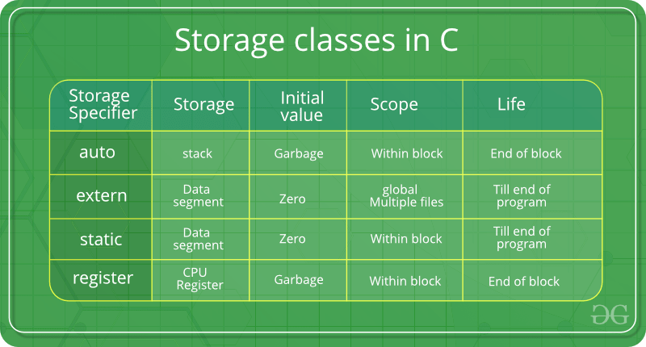
Types of Storage Classes in C
Storage class | Purpose
auto | It is a default storage class.
extern | It is a global variable.
static | It is a local variable which is capable of returning a value even when control is transferred to the function call.
register | It is a variable which is stored inside a Register.

Slide 18
Auto Storage Class in C
The variables defined using auto storage class are called as local variables. Auto stands for automatic storage class. A variable is in auto storage class by default if it is not explicitly specified.
The scope of an auto variable is limited with the particular block only. Once the control goes out of the block, the access is destroyed. This means only the block in which the auto variable is declared can access it.

Slide 19
Extern Storage Class in C
Extern stands for external storage class. Extern storage class is used when we have global functions or variables which are shared between two or more files.
Keyword extern is used to declaring a global variable or function in another file to provide the reference of variable or function which have been already defined in the original file.
The variables defined using an extern keyword are called as global variables. These variables are accessible throughout the program.

Slide 20
Static Storage Class
This type of storage class gives an instruction to a compiler to keep the given local variable around during the program’s lifetime- instead of creating it and then destroying it every time it comes into a scope and goes out of it. Thus, when we make a local variable static, it allows the variable to maintain the values that are available between various function calls.
Features of static variables:
Those variables that we define as static specifiers are capable of holding their assigned value that exists between various function calls.
The static local variables are only visible to the block or the function in which we have defined them.
We can declare the very same static variable multiple times, but we can only assign it a single time.
The initial value of a static integral variable, by default, is 0. Else, it is null.
We use the static keyword in the case of a static variable.
The visibility of any static global variable stays limited to that file in which we have declared it.

Slide 21
Register Storage Class
We use the register storage class for defining the local variables that must be stored in any register, and not in a RAM. It means that the maximum size of this variable is equal to that of the register size (it is usually one word).
Features of register variables:
Those variables that we define as the register have their memory allocation into the CPU registers. It depends totally upon the size of the memory that remains in the CPU.
Its access time is comparatively much faster than that of the automatic variables.
The default initial value of any given register local value will always be 0.
We use the register keyword for the variable that must be stored in a CPU register. However, whether a variable must be stored in a register or not is always going to be the choice of the compiler.
One can easily store the pointers in a register. It means that any register is capable of storing the given variable’s address.
We cannot store a variable into a register since we can’t really utilize more than one storage specifier for the very same variable.

Slide 22
#include<stdio.h> int main(){ printf(“Thank you\n”); return 0; }

